Slide 1
TELEGRAM CONTROLLED HOME AUTOMATION USING NODEMCU ESP8266

Slide 2
Contents
Introduction
Required Components
Implementation
Source Code
Output

Slide 3
Introduction
Home automation now becomes an essential part of IoT applications and people use their smartphone to control home appliances from anywhere over internet. There are various ways to control AC appliances with smartphone.
In this IoT project we will control an AC lamp with a text message from Telegram application using NodeMCU.

Slide 4
Components required
Hardware:
ESP8266 NodeMCU
Lamp
Jumper wires
Breadboard
Relay module
Battery / Power Supply
Software:
Arduino IDE (v1.6 or above)
Telegram Bot

Slide 5
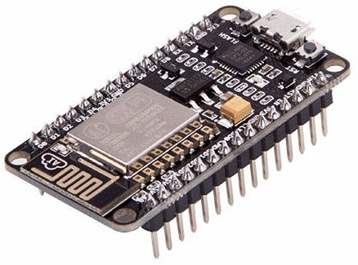
Nodemcu
NodeMCU is a low-cost open source IoT platform. It initially included firmware which runs on the ESP8266 Wi-Fi SoC from Espressif Systems, and hardware which was based on the ESP-12 module. Later, support for the ESP32 32-bit MCU was added.
NodeMCU is an open source firmware for which open source prototyping board designs are available. The name "NodeMCU" combines "node" and "MCU" (micro-controller unit).[8] The term "NodeMCU" strictly speaking refers to the firmware rather than the associated development kits.

Slide 6
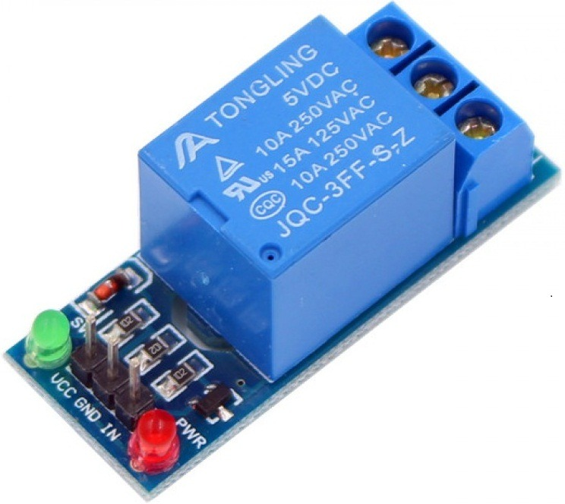
Relay module
The relay is the device that open or closes the contacts to cause the operation of the other electric control. It detects the undesirable condition with an assigned area and gives the commands to the circuit breaker to disconnect the affected area through ON or OFF.
Every electromechanical relay consists of
1. Electromagnet
3. Mechanically movable contact
3. Switching points and
4. Spring.

Slide 7
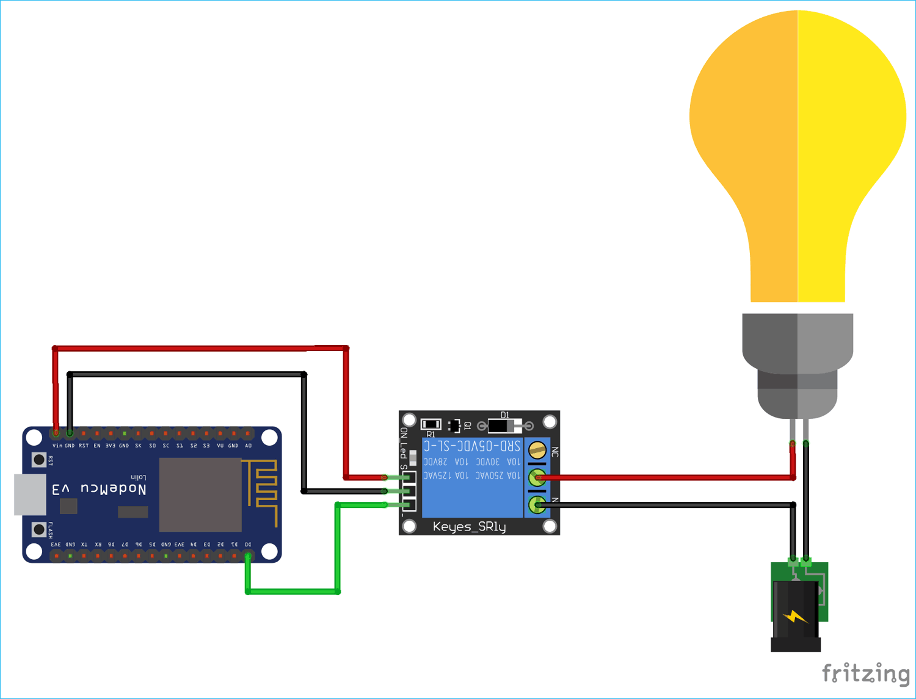
Circuit Diagram

Slide 8
implementation
Here 1st we need to load the code into NodeMCU and then we need to connet the NodeMCU with power and WIFI connection so that it works fine.
After the code gets compiled successfully we need to open the telegram bot.
After opening the Telegram Bot we need to click on START. Now the bot starts replying the user. Bot keeps the commands which the user can use. The user needs to click on the command so that the command will work.
If it is Light On then the light which we connected will ON.
If it is Light Off then the light which we connected will go OFF.
If it is Byee then it Sends off the user with a message.
If it is Help me the loop will be continued.

Slide 9
algorithm
Step 1: Start
Step 2: Check whether WIFI is connected to NODEMCU , if WIFI connected goto Step3. Else goto Step 9.
Step 3: Code in NodeMCU is processed and now telegram bot will be active.
Step 4: If the Telegram access token is true then goto Step 5.Else goto Step 9.
Step 5: /start
Step 6: /helpme
Step 7: Now 4 commands will be displayed. /LIGHT_ON,/LIGHT_OFF,/helpme,/bye
Step 8: If /LIGHT_ON:
Light will on and bot replies as LIGHT will be ON.
Else If /LIGHT_OFF:
Light off and bot replies ad LIGHT will OFF.
Else If /helpme :
Goto Step 6.
Else If /bye:
Nothing happens and bot replies as Byee See you soon.
Else:
Goto Step 4.
Step 9: End.

Slide 10
Source code
#include "CTBot.h"
CTBot myBot;
String ssid = "VARSHA"; // REPLACE mySSID WITH YOUR WIFI SSID
String pass = "9866028800";
// REPLACE myPassword YOUR WIFI PASSWORD, IF ANY
String token = "5482254733:AAFeAVFLEtt5c83Sc6rE9oyiP2sD5E1By5Y"; // REPLACE myToken WITH YOUR TELEGRAM BOT TOKEN
uint8_t led = D0; // the onboard ESP8266 LED.
// If you have a NodeMCU you can use the BUILTIN_LED pin
// (replace 2 with BUILTIN_LED)

Slide 11
Source code
void setup() {
Serial.begin(115200);
Serial.println("Starting TelegramBot...");
myBot.wifiConnect(ssid, pass);
myBot.setTelegramToken(token);
if (myBot.testConnection())
Serial.println("\ntestConnection OK");
else
Serial.println("\ntestConnection NOK");
pinMode(led, OUTPUT);
digitalWrite(led, HIGH); // turn off the led (inverted logic!)
}

Slide 12
Source code
void loop() {
TBMessage msg
if (myBot.getNewMessage(msg)) {
if (msg.text.equalsIgnoreCase("/LIGHT_ON")) { // if the received message is "LIGHT ON"...
digitalWrite(led, LOW); // turn on the LED (inverted logic!)
myBot.sendMessage(msg.sender.id, "Light is now ON 💡 "); // notify the sender
}
else if (msg.text.equalsIgnoreCase("/LIGHT_OFF")) { // if the received message is "LIGHT OFF"...
digitalWrite(led, HIGH); // turn off the led (inverted logic!)
myBot.sendMessage(msg.sender.id, "Light is now OFF"); // notify the sender
}
else if (msg.text.equals("/helpme")) {
digitalWrite(led, HIGH);
myBot.sendMessage(msg.sender.id, "Try sending following commands\n");
myBot.sendMessage(msg.sender.id, "/LIGHT_ON\n");
myBot.sendMessage(msg.sender.id, "/LIGHT_OFF\n");
myBot.sendMessage(msg.sender.id, "/helpme\n");
myBot.sendMessage(msg.sender.id, "/Byee\n");
}

Slide 13
Source code
else if (msg.text.equals("/Byee")){
String r;
r = (String)"Byeeee " + msg.sender.username + (String)" .See you soon 👋 !!! ";
myBot.sendMessage(msg.sender.id, r);
}
else { // otherwise...
// generate the message for the sender
String reply;
reply = (String)"Welcome 😃 " + msg.sender.username + (String)".Try /helpme";
myBot.sendMessage(msg.sender.id, reply); // and send it
}
}
// wait 500 milliseconds
delay(500);
}

Slide 14
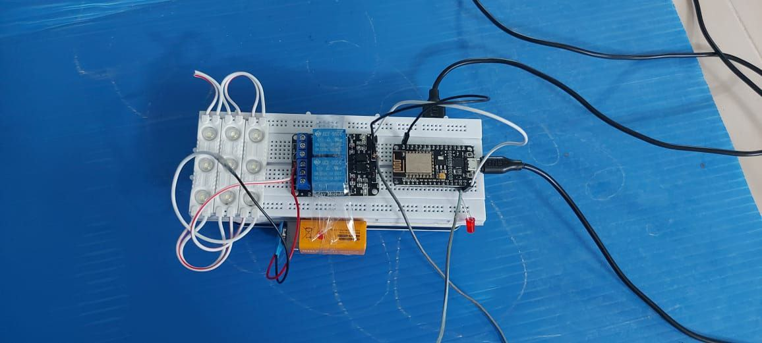
Output
Light off

Slide 15
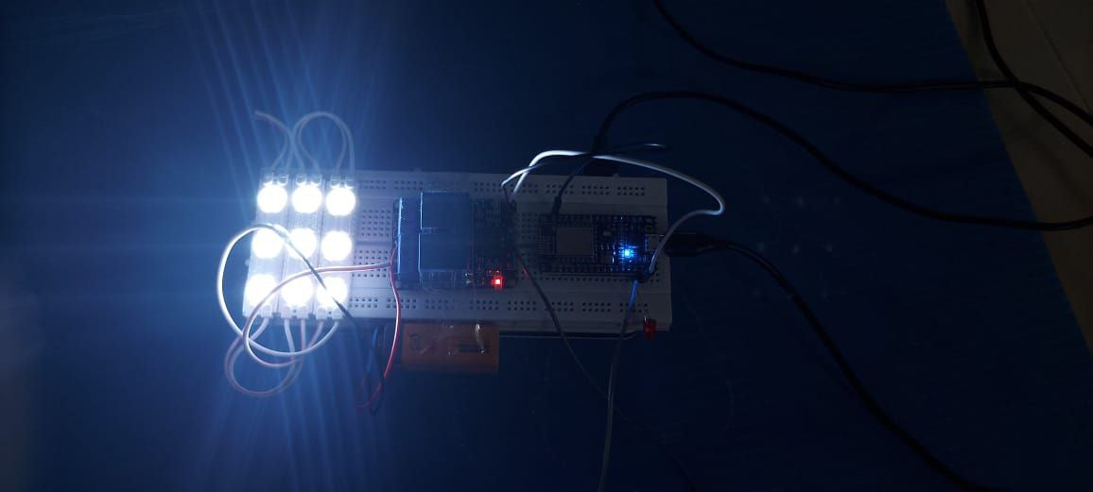
output
Light On

